Slide 1
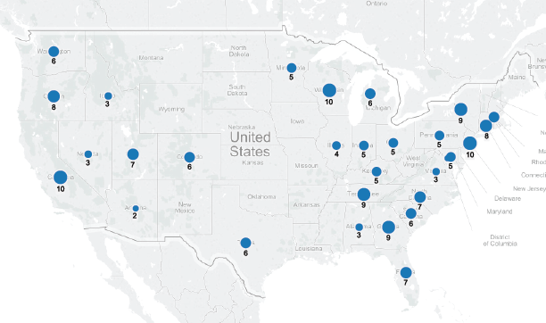
May Job Growth (+180K)

Slide 2
ADP vs. BLS
Monthly comparison
Button
Notes:
Correlation over entire period, mean absolute difference between both over entire period.
Change and vary time periods, and do correlation and mean absolute difference.

Slide 3
Monthly Comparison of ADP vs. BLS
Monthly comparison
Result of selecting button
Notes:
Change time periods for this.

